Slide 1


Predictive Analysis of Client Responses to Phone-Based Marketing Campaigns
Predicting Term Deposit Subscriptions in a Portuguese bank through Phone Campaigns

Slide 2
Table of Contents

Slide 3
Intro + Problem Statement - ishita [2 min]
Data exploration [1min]
Data preprocessing: remove variables + discretization for BM1 [2min]
Methodology - Jiayi [2 min]
BM1
3 models: results [Siyi] [SVM, logistic regression, naive bayes]
2 models: results [Shu Wei] [Decision, Random Forest]
Conclusion [Shu Wei]
BM2:
Data preprocessing: removing duration and campaign [Chun Yun]
3 models [Siyi]
2 models [Shu Wei]
Conclusion [Jiayi][2 min]
Overall conclusion + future works [Ishita]

Slide 4

Introduction
Telemarketing is the use of phones, sms, internet etc. to sell goods/services.
It is a way to provide more interactive and personal sales service to the customers.
Widespread in various sectors such as banks,healthcare,real estate etc.

Slide 5

Introduction
Highly efficient marketing strategy.
Helps to focus resources on the pool of customers highly likely to subscribe to the goods/service being provided.
This is a classification task, where Supervised Machine Learning algorithms can be developed to predict the success of the telemarketing campaign.

Slide 6

Problem Statement
The data is the Bank Marketing dataset, based on the telemarketing campaign conducted by the Portuguese retail bank. The campaign assessed whether the customers will subscribe to the term deposit.
We utilize the CRoss Industry Standard Process Data Mining (CRISP-DM),a widely used analytics model framework, utilized as a base for a data science process.
There is no deployment in our project, but it is interesting to move through the phases.

Slide 7

Business Understanding
A term deposit is a type of deposit account at a financial institution where the money is locked up for some set period of time. They are usually short-term deposits and considered safe investment.
In our project, the Portuguese Bank uses the approach of direct marketing to access whether the customer is interested in subscribing to the term deposit or not.

Slide 8
Business Model
The aim of the project is to:
Business Model 1: Conduct analysis (after the last contact with the customer via phone), that is to determine after a phone call whether the customer will subscribe to the term deposit offered by the bank or not.
Business Model 2: Perform analysis to determine potential subscribers for term deposit offered by the bank for future campaigns.

Slide 9
Data Description
Response Variable | description | type | e.g.
y | has the bank client subscribed to a term deposit? | binary | yes, no

Slide 10
Data Description
Explanatory Variable | description | type | e.g.
age | Age of client | numeric | 58,44,33,47
job | type of job |  | admin., unknown, unemployed,management,housemaid, entrepreneur, student, blue-collar, self-employed, retired, technician, services
marital | marital status | categorical | married,divorced,single; note: "divorced" means divorced or widowed
education | Highest education level of bank client | categorical | "Primary","secondary", "tertiary","unknown"
default | Does the client have credit in default? | binary | yes, no
balance | average yearly balance, in euros | numeric
housing | Does the client have existing housing loan? | binary | yes, no
loan | Does the client have existing personal loan? | binary | yes, no
contact | contact communication type | categorical | Unknown, telephone, cellular

Slide 11
Data Description
Explanatory Variable | description | type | e.g.
day | last contact day of the month | numeric | 1,2,3,4,5,6,7
month | last contact month of year | categorical | "jan", "feb", "mar", ..., "nov", "dec"
duration: | last contact duration, in seconds | numeric | 261,151,76…
campaign | number of contacts performed during this campaign and for this client (includes last contact) | numeric
pdays | number of days that passed by after the client was last contacted from a previous campaign | numeric | -1 means client was not previously contacted
previous | number of contacts performed before this campaign and for this client | numeric
poutcome | outcome of the previous marketing campaign | categorical | Unknown, other, failure, success

Slide 12
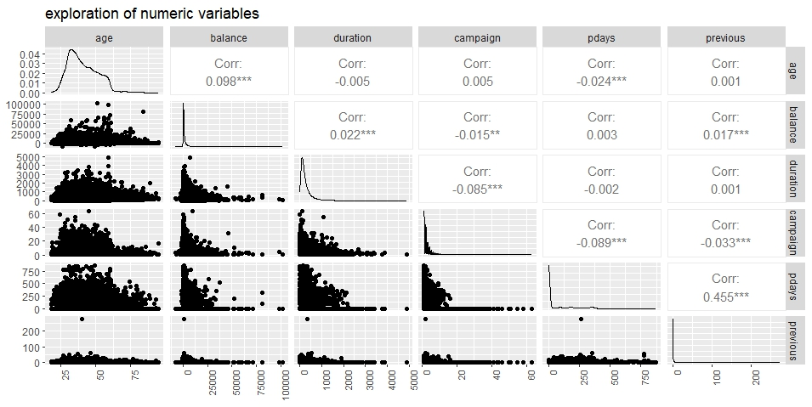
Data Exploration: numeric variables
Most numeric variables are very weakly correlated, with the exception of ‘pdays’ & ‘previous’.
Notes:
Mix of characteristics of the customer and the nature of the ball

Slide 13
Data Exploration: numeric variables
There is an extreme outlier for ‘previous’

Slide 14
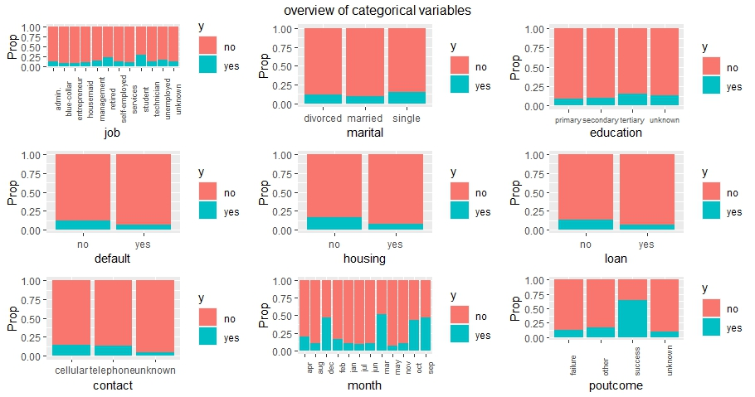
Data Exploration: categorical variables

Slide 15
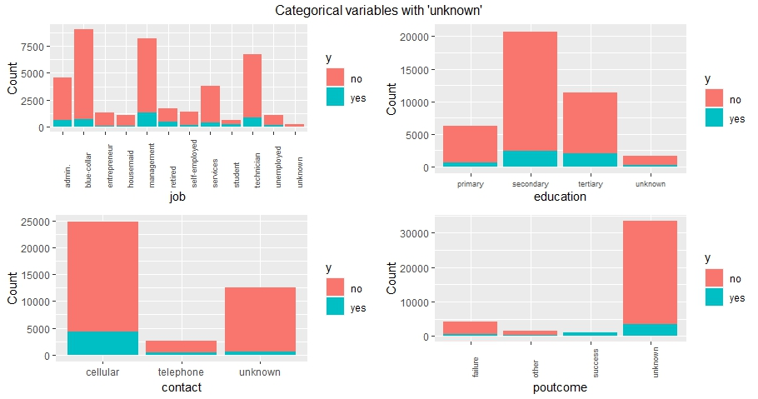
Data Exploration: variables with unknowns

Slide 16
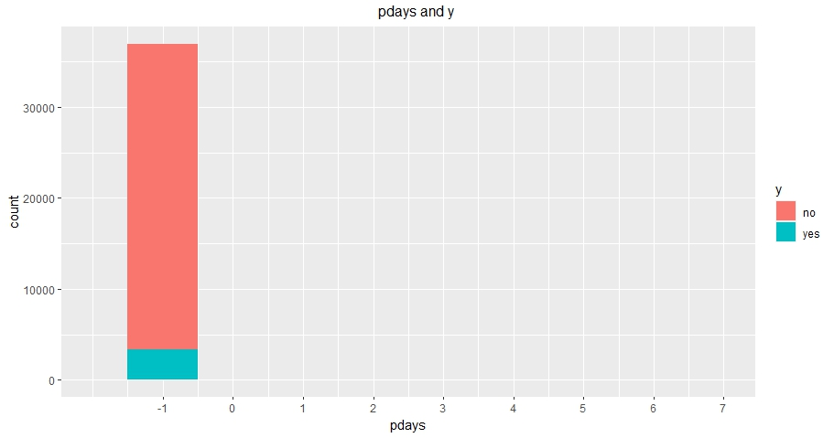
Data Exploration: pdays and y

Slide 17
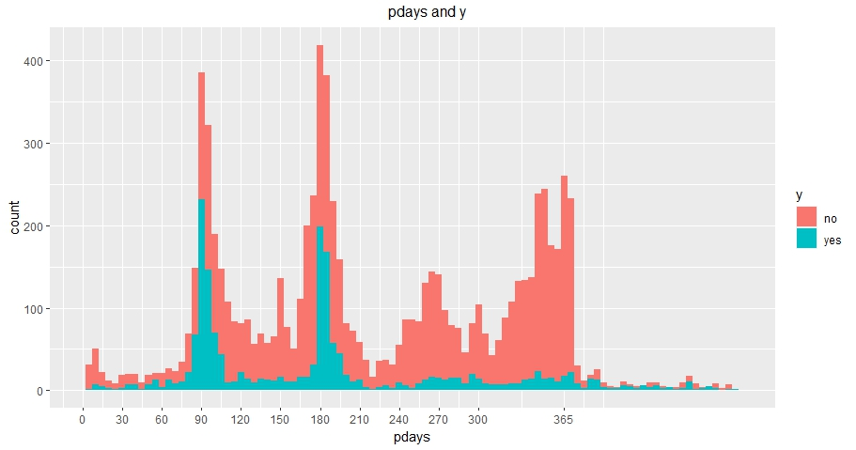
Data Exploration: pdays and y

Slide 18
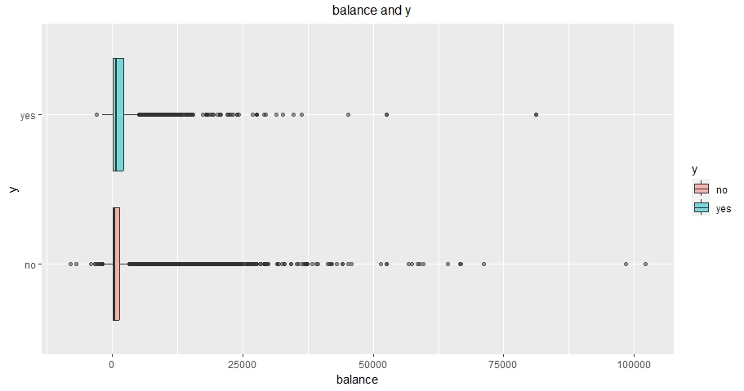
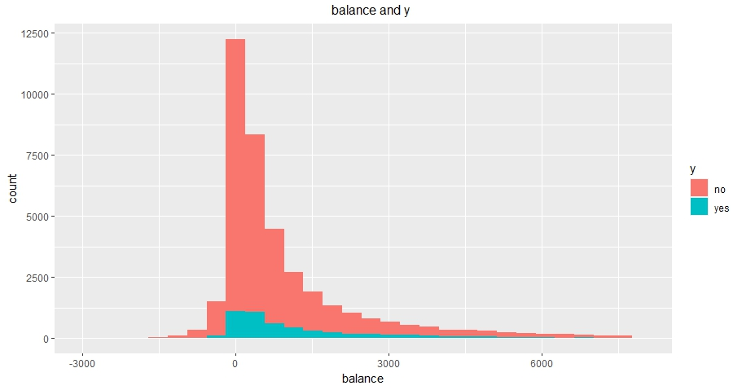
Data Exploration: balance and y

Slide 19
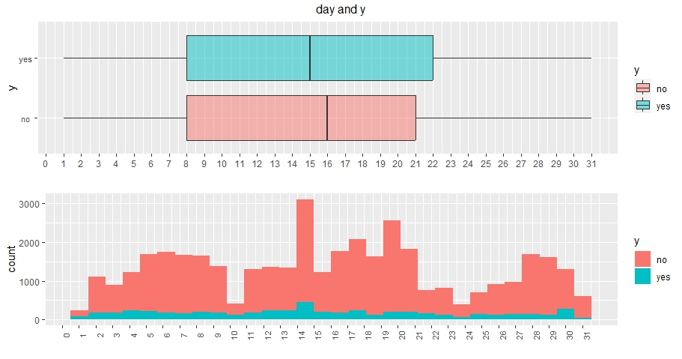
Data Exploration: day and y

Slide 20
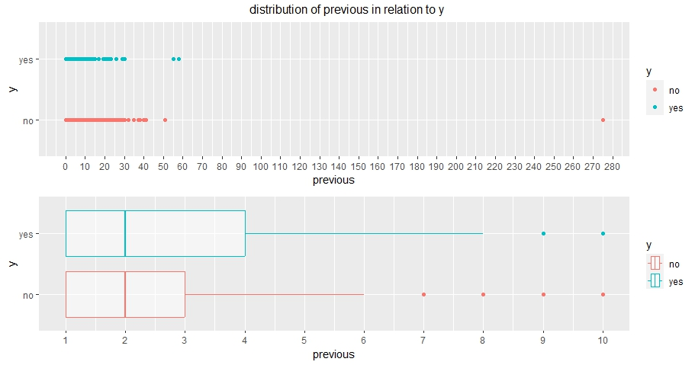
Data Exploration: previous and y

Slide 21
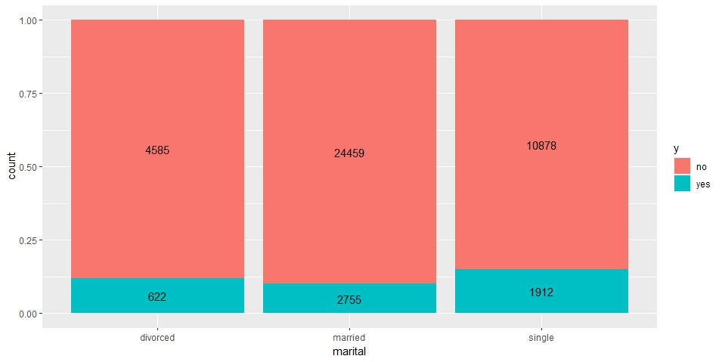
Data Exploration
singles have highest proportion of subscribing.

Slide 22
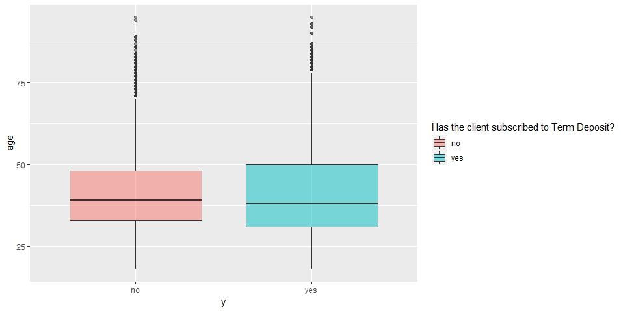
Data Exploration
age range as well as median age are similar across both class values, could suggest that age may not be a predictor of high importance

Slide 23
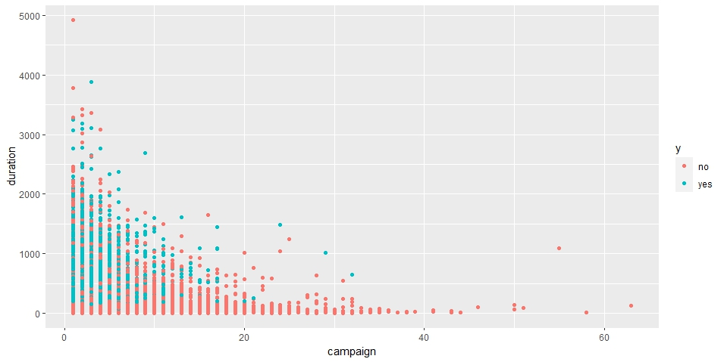
Data Exploration:
spread of y across ‘campaign’ and ‘duration’
No. of customers subscribing is higher when number of contacts performed are low and duration of call is longer (>5 min)

Slide 24
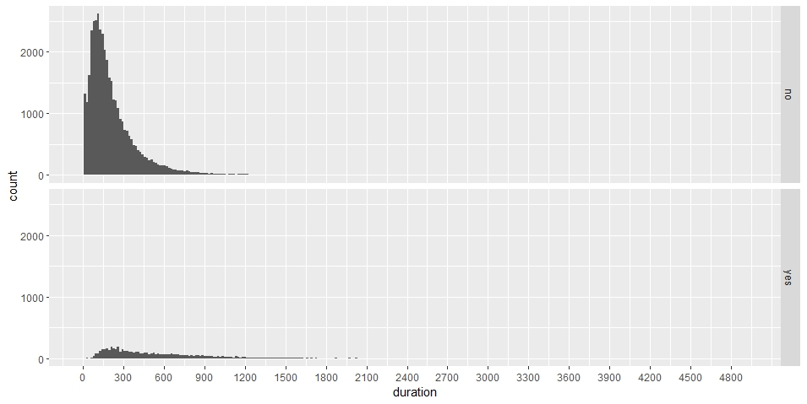
Data Exploration: duration & y
Most calls end within 600 seconds (10 mins) across both class values.
the mean call duration is longer for those who subscribed

Slide 25
Data Exploration: month & y

Slide 26
Data Exploration: day & y

Slide 27
Data Preprocessing: removal of ‘poutcome’
Majority of records have ‘unknown’ value.
Imputation using mean/median is not an option as redistributing 2/3 of the records with ‘unknown’ value to the other 3 category values may be giving extra information to the model that may cause overfitting

Slide 28
Data Preprocessing: discretization of ‘pdays’
‘Pdays’ has a ‘-1’ value assigned if there was no previous contact
→ overwhelming majority of observations have ‘-1’ value.
→ as a numeric variable, it has a very weak correlation with target variable
→ interpretation of ‘Pdays’ as a numeric variable is not very useful.
Discretized into 5 categories of values:
"nc", "1_90d", "91_180d", "181_270d", "271d_plus"

Slide 29
Data Preprocessing: discretization of ‘previous’
Extreme outlier: ‘275’ calls suggest bank called them 275 times previously!
Huge range of values, but mostly clustered between 1-7 calls.
→ the observation that higher mean number of contacts were performed for those who subscribed could be skewed by outliers
→ we can remove the effect of outliers by binning them under ‘8c_plus’
Discretized into 7 categories of values:
"nc", "1c", "2c", "3c", "4c", "5c", "6c", "7c", "8c_plus"

Slide 30
Data Preprocessing: feature selection
Boruta algorithm: all features except ‘default’ are selected
Recursive Feature Elimination: all features are selected
Given that Boruta algorithm is more rigorous than RFE, we will do feature selection according to the results of Boruta algorithm.

Slide 31
Methodology
Discretize:
previous, pdays
5-fold CV
Remove:
Default, Poutcome
Pre-
processing
Business Model 1
BM1 Tuning
Evaluation
Random forest
SVM
Decision tree
Logistic Regression
Naive Bayes
MCC
Accuracy
Sensitivity
Specificity
AUC

Slide 32
Methodology
Discretize:
previous, pdays
5-fold CV
Remove:
Default, Poutcome, duration, campaign
Pre-
processing
Business Model 2
BM2 Tuning
Evaluation
Random forest
SVM
Decision tree
Logistic Regression
Naive Bayes
MCC
Accuracy
Sensitivity
Specificity
AUC

Slide 33
Methodology
Why pick which model to do which part, short it into 2 slides.
Bm1 bm2

Slide 34
Methodology: Model Choosing
All 5 models are ensemble machine learning technique, commonly used for classification
Logistic Regression：
Predicts the output of a categorical dependent variable => the outcome must be categorical or discrete.
Has the ability to provide probabilities values which lie between 0 and 1 and classify new data using continuous and discrete datasets.
Strengths: (1) easier to implement, interpret, and efficient to train, (2) less inclined to over-fitting.
Naive Bayes:
Based on probability theory and uses a Bayesian formula to calculate the posterior probability of categories.
Works well for problems in which information from numerous attributes should be considered simultaneously to estimate the overall probability of an outcome.
Strengths: (1) easier to implement, interpret, and efficient to train, (2) not prone to overfitting

Slide 35
Methodology: Model Choosing
SVM:
Aim to find an optimal hyperplane to classify data points.
Principle: Maximize margin between boundary and closest data (support vectors).
Strengths: Works well in high dimensions; handles non-linearities using kernel trick.
Decision Tree
Use tree to class the data points.
Some algorithms (eg: C5.0) of Decision Tree allow multiple attempts, and each attempt constructs a new decision tree model. From all of them, C5.0 selects the best one.
Strengths: Less sensible to extreme values; Easy to understand.
Random Forest
Operates by constructing multitude of decision trees during the training step.
Output of the model is the class that is represented by most trees.
Strengths: Combines multiple decision trees, which improves model performance.

Slide 36
Business Model 1

Slide 37
Support Vector Machine
Use 5-folds cross validation
Upsampling the unbalanced class with ROSE package
Scale the numerical columns

Slide 38
Support Vector Machine: Tuning the Parameters
Three common types of Kernels for SVM are:
Linear Kernel: Represents a linear decision boundary; optimal for linearly separable data.
Polynomial Kernel: Introduces polynomial decision boundaries; complexity is determined by polynomial degree.
RBF Kernel: Versatile; captures a variety of data shapes using a Gaussian function; complexity controlled by spread parameter.
For our dataset, we choose RBF Kernel since it tends to generalize well, especially when the hyperparameters are optimized through techniques like cross-validation.

Slide 39
Support Vector Machine: Tuning the Parameters
Parameters for RBF Kernel:
C (Regularization Parameter):
Adjusts the trade-off between maximizing the margin and minimizing classification errors.
High values prioritize correct classification but risk overfitting; low values prioritize margin width possibly at the cost of misclassifications.
Gamma (γ)(Sometimes referred as Sigma σ):
Determines the spread of the RBF kernel.
Smaller σ (or higher γ) results in a tighter, more localized decision boundary, which can risk overfitting.
Larger σ (or lower γ) produces a broader and more general decision boundary, which can risk underfitting.
After trying different parameters with a tuning grid, the best C is 10 and σ is 0.1 for all folds.

Slide 40
Support Vector Machine: Results
Metrics | Business Model 1 | After tuning
Average MCC | 0.5185 | 0.5332
Average Accuracy | 0.8311 | 0.8476
Average Sensitivity | 0.8245 | 0.8460
Average Specificity | 0.8815 | 0.8588
Average AUC | 0.8530 | 0.8524

Slide 41
Support Vector Machine: Conclusion
Discretization on ‘previous’ and ‘pdays’ does not have a significant effect on the model’s performance.
An MCC of 0.45 suggests that model's binary classification performance is moderately good.
Tuning the parameter increases the mcc by 4% and specificity by 10%.
High sensitivity = accurately identifies most clients who will subscribe.
Ensures most interested clients are targeted.
Reduces missed opportunities for securing subscriptions.

Slide 42
Support Vector Machine: Conclusion
Low specificity = often predicts clients will subscribe when they actually won't
Leads to targeting uninterested clients.
Results in wasted marketing resources.
Potential client dissatisfaction from repeated undesired outreach.
Not high auc
SVM is computationally intensive, especially for large datasets like ours. Taking into account its moderate performance, SVM might not be the most optimal choice for solving the two business problems.

Slide 43
Logistic Regression: Introduction
supervised machine learning algorithm mainly used for classification tasks
predicts the output of a categorical dependent variable => the outcome must be a categorical or discrete value
has the ability to provide probabilities values which lie between 0 and 1 and classify new data using continuous and discrete datasets
can be classified into three types: Binomial, Multinomial, Ordinal
Strengths: (1) easier to implement, interpret, and very efficient to train, (2) less inclined to over-fitting
Limitations: assumption of linearity between the dependent variable and the independent variables.
Notes:
Binomial: In binomial Logistic regression, there can be only two possible types of the dependent variables, such as 0 or 1, Pass or Fail, etc.
Multinomial: In multinomial Logistic regression, there can be 3 or more possible unordered types of the dependent variable, such as “cat”, “dogs”, or “sheep”
Ordinal: In ordinal Logistic regression, there can be 3 or more possible ordered types of dependent variables, such as “low”, “Medium”, or “High”.

Slide 44
Logistic Regression
Results of the baseline model and model 2 using logistic regression
Metrics | Model | Model (After improvement)
Average MCC | 0.4402 | 0.4789
Average Accuracy | 0.7496 | 0.8859
Average Sensitivity | 0.9272 | 0.5786
Average Specificity | 0.7261 | 0.9266
Average AUC | 0.9015 | 0.9015
Notes:
c=0.9 (for improvement of model)

Slide 45
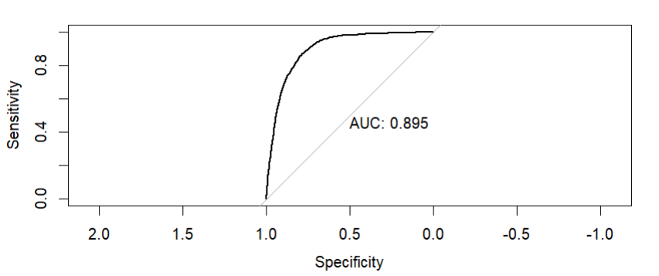
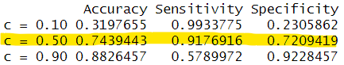
Logistic Regression: Cut off point
Although our models give relatively good accuracy results => is the cutoff point (c) of 0.5 in the models used optimal?
Looking at the AUC => high AUC
Has a high sensitivity and specificity
balanced trade-off between sensitivity and specificity
After exploring a few cut off points, c= 0.5 seems like a reasonable choice

Slide 46
Naive Bayes Classifier
Application of Bayes’ theorem to classification problems.
‘ Naive’ assumption that all of the features in the dataset are equally important and independent
Naive Bayes uses frequency tables for learning the data
→ classification works best if each feature is categorical.
→ performed discretisation for all numeric variables
Works well for problems in which information from numerous attributes should be considered simultaneously to estimate the overall probability of an outcome.
→ While many ML algorithms ignore features that have weak effects, this utilizes all available evidence to subtly change the predictions

Slide 47
Naive Bayes Classifier: improving its performance
If a given feature & class value do not occur together in the training data, posterior probability of class value will be reflected as zero. This may not be accurate!
Laplace smoothing by tuning Laplace estimator ensures value that each feature has a nonzero probability of occurring with each class
→ tune based on laplace estimator value of 1:5, choose the value that gives highest MCC
Notes:
Bayesian classifiers are best applied to problems for which the information from numerous
attributes should be considered simultaneously to estimate the overall probability of
an outcome. While many machine learning algorithms ignore features that have weak effects,
Bayesian methods utilize all available evidence to subtly change the predictions. This implies
that even if a large portion of features have relatively minor effects, their combined impact in a
Bayesian model could be quite large

Slide 48
Naive Bayes Classifier: improving its performance
Naive Bayes assumes that all features are independent of each other,
BUT
given known class value, pdays & previous are highly associated with each other.
remove 1 out of any pair of features that have strong, statistically significant association with each other.
→ Cramer’s V coefficient is used to determine strength of association between categorical variables
→ Cramer’s V coefficient for ‘pdays’ & ‘previous’ is significant and large
→ ‘previous’ is removed.
Notes:
Bayesian classifiers are best applied to problems for which the information from numerous
attributes should be considered simultaneously to estimate the overall probability of
an outcome. While many machine learning algorithms ignore features that have weak effects,
Bayesian methods utilize all available evidence to subtly change the predictions. This implies
that even if a large portion of features have relatively minor effects, their combined impact in a
Bayesian model could be quite large

Slide 49
Naive Bayes Classifier:Results
Results for Naive Bayes Classifier model.
The metrics displayed are with respect to the positive label (yes).
Metrics | Model | Model (After improvement)
Average MCC | 0.4221 | 0.4350
Average Accuracy | 0.7921 | 0.7946
Average Sensitivity | 0.7964 | 0.8151
Average Specificity | 0.7915 | 0.7919
Average AUC | 0.8729 | 0.8796
Laplace smoothing improves performance slightly.
removing of 1 out of the pair of strongly associated features improves performance significantly.
Notes:
Sensitivity: maximizing business opportunities
Specificity: resource management (cost management, manpower deployment)

Slide 50
Decision Tree
Decision tree models construct a tree structure to do classification or prediction.
There are some commonly used algorithms for Decision Tree, eg: C4.5, C5.0, CART, etc.. These algorithms differ in their decision tree construction and splitting strategies.
In our project, we construct a decision tree model using the C5.0.
C5.0 algorithm allows multiple attempts, and each attempt constructs a new decision tree model. From all of them, C5.0 selects the best one.
Strengths: Less sensible to extreme values; Easy to understand.
Limitations: Prone to overfitting; Sensitive to imbalanced dataset; Small changes in data may lead to different decision trees (unstable).

Slide 51
Decision Tree: Tuning
Performance of the Decision Tree model may vary according to the settings of the number of the trials, so we adjust it to try to find better model.
Larger values of “trials” can help find better models. Combining predictions from multiple models for more accurate classification. We set trials=10 to boost the decision tree model.

Slide 52
Decision Tree: Results
All models showed that y class should be “Yes”
Tuning the parameter increases the mcc by 4%.
Metrics | Model | After tuning
Average MCC | 0.4614 | 0.4991
Average Accuracy | 0.8706 | 0.8941
Average Sensitivity | 0.6186 | 0.5738
Average Specificity | 0.9040 | 0.9365
Average AUC | 0.8931 | 0.9816

Slide 53
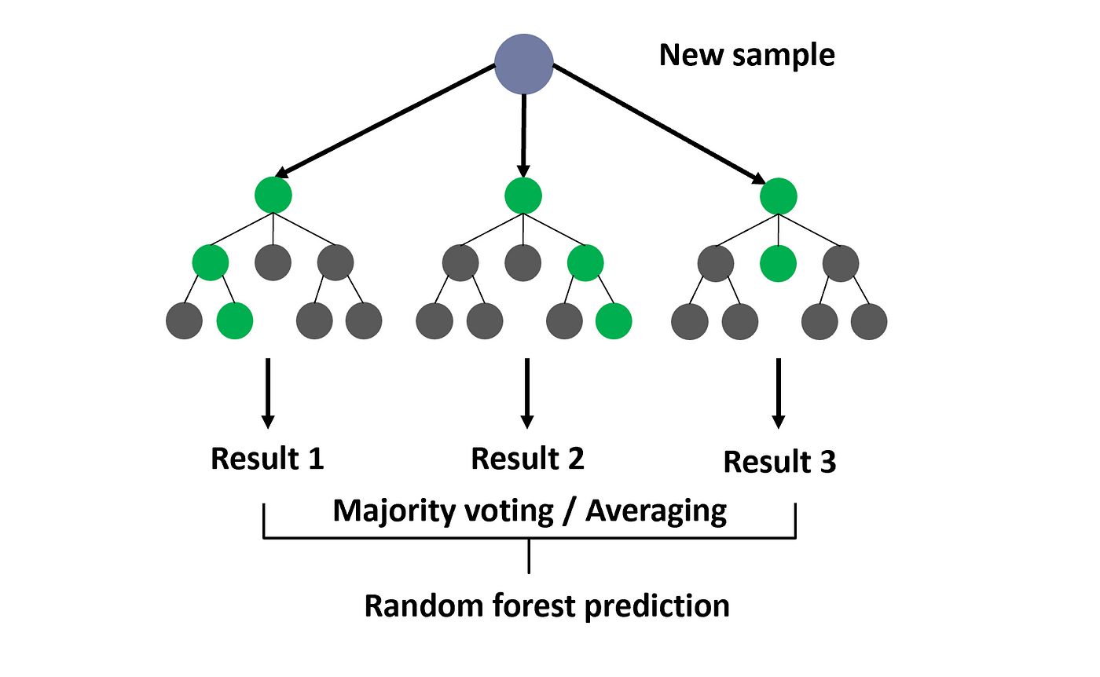
Random Forest
Random forest is an ensemble machine learning technique, commonly used for classification and regression.
This technique operates by constructing multitude of decision trees during the training step.
For classification problems the output of the model is the class that is represented by most trees.

Slide 54
Random Forest:Results
Results for Random Forest model.
The metrics displayed are with respect to the positive label (yes).
Metrics | Model | Model (Tune)
Average MCC | 0.5503 | 0.5598
Average Accuracy | 0.9012 | 0.8887
Average Sensitivity | 0.6470 | 0.7438
Average Specificity | 0.9348 | 0.9079
Average AUC | 0.9309 | 0.9272

Slide 55
Summary of the models across the metrics
Metrics | SVM | DT | LG | RF | NB
Average MCC | 0.4789 | 0.4991 | 0.4789 | 0.5598 | 0.4350
Average Accuracy | 0.8476 | 0.8941 | 0.8859 | 0.8887 | 0.7946
Average Sensitivity | 0.8460 | 0.5738 | 0.5786 | 0.7438 | 0.8151
Average Specificity | 0.8588 | 0.9365 | 0.9266 | 0.9079 | 0.7919
Average AUC | 0.8524 | 0.9816 | 0.9015 | 0.9272 | 0.8796
XXX i
Notes:
Take the figures (after tuning the model)

Slide 56
Business Model 1:Conclusion
Quite costly for banks to miss out potential customers who may subscribe to their time deposits => Models that are able to do well in classifying their banking customers are deemed important
If the bank does have more resources
Can invest in heavy duty models like RF, DT (bagging) and AdaBoost
Such ensemble learning models are usually beneficial as they tend to be more flexible and less data-sensitive
If the bank does not have much resources
Lighter models like LG would be a better investment as it is easier to implement, interpret, and very efficient to train
As compared to SVM which is computationally heavy, LG is a much better choice.

Slide 57
Business Model 1:Conclusion
For every organisation, including bank: To max revenue and min. Cost
Each model performs well based on the objective of the bank.
SVM - to find out which clients subscribe? Since it has high sensitivity => maximize business opportunity
DT/RF - to find out which clients will not subscribe? Since it has high specificity => cost savings since it reduced the number of false alarms such as following up with uninterested clients
Bank should target singles and those without a loan as they are more likely to subscribe to time deposit

Slide 58
Business Model 1:Conclusion
Out of all the models, which model is performing the best?
XXX

Slide 59
Business Model 2

Slide 60
Support Vector Machine: Results
Metrics | Business Model 2 | After tuning
Average MCC | 0.3376 | 0.3580
Average Accuracy | 0.8053 | 0.8216
Average Sensitivity | 0.8322 | 0.8517
Average Specificity | 0.6016 | 0.5939
Average AUC | 0.7169 | 0.7228

Slide 61
Logistic Regression
Results of the baseline model and model 2 using logistic regression
Metrics | Model | Model (After improvement)
Average MCC | 0.2655 | 0.3084
Average Accuracy | 0.7233 | 0.8664
Average Sensitivity | 0.6495 | 0.3521
Average Specificity | 0.7331 | 0.9346
Average AUC | 0.7517 | 0.7517
Notes:
c=0.7 (for improvement of model)

Slide 62
Naive Bayes Classifier: Results
The metrics displayed are with respect to the positive label (yes)
Attempts to improve the model include tuning of laplace value & removing 1 feature (‘previous_disc’) out of a pair of strongly associated features.
However, unlike BM1, removing ‘previous_disc’ marginally reduces the MCC.
Metrics | Model | After improvement
Average MCC | 0.2617 | 0.2620
Average Accuracy | 0.7175 | 0.7179
Average Sensitivity | 0.6532 | 0.6530
Average Specificity | 0.7260 | 0.7265
Average AUC | 0.7497 | 0.7500

Slide 63
Decision Tree: Results
Metrics | Model | After tuning
Average MCC | 0.2212 | 0.3007
Average Accuracy | 0.8066 | 0.8709
Average Sensitivity | 0.3974 | 0.3197
Average Specificity | 0.8608 | 0.9439
Average AUC | 0.7156 | 0.9816

Slide 64
Random Forest:Results
Results for Random Forest model.
The metrics displayed are with respect to the positive label (yes).
Metrics | Model | Model (Tune)
Average MCC | 0.3513 | 0.3770
Average Accuracy | 0.8698 | 0.8573
Average Sensitivity | 0.4100 | 0.5095
Average Specificity | 0.9307 | 0.9034
Average AUC | 0.7821 | 0.7843

Slide 65
Summary of the BM2 models across the metrics
Metrics | SVM | DT | LG | RF | NB
Average MCC | 0.3580 | 0.3007 | 0.3084 | 0.3770 | 0.2606
Average Accuracy | 0.8216 | 0.8709 | 0.8664 | 0.8573 | 0.7082
Average Sensitivity | 0.8517 | 0.3197 | 0.3521 | 0.5095 | 0.6680
Average Specificity | 0.5939 | 0.9439 | 0.9346 | 0.9034 | 0.7136
Average AUC | 0.7228 | 0.9816 | 0.7517 | 0.7843 | 0.7517

Slide 66
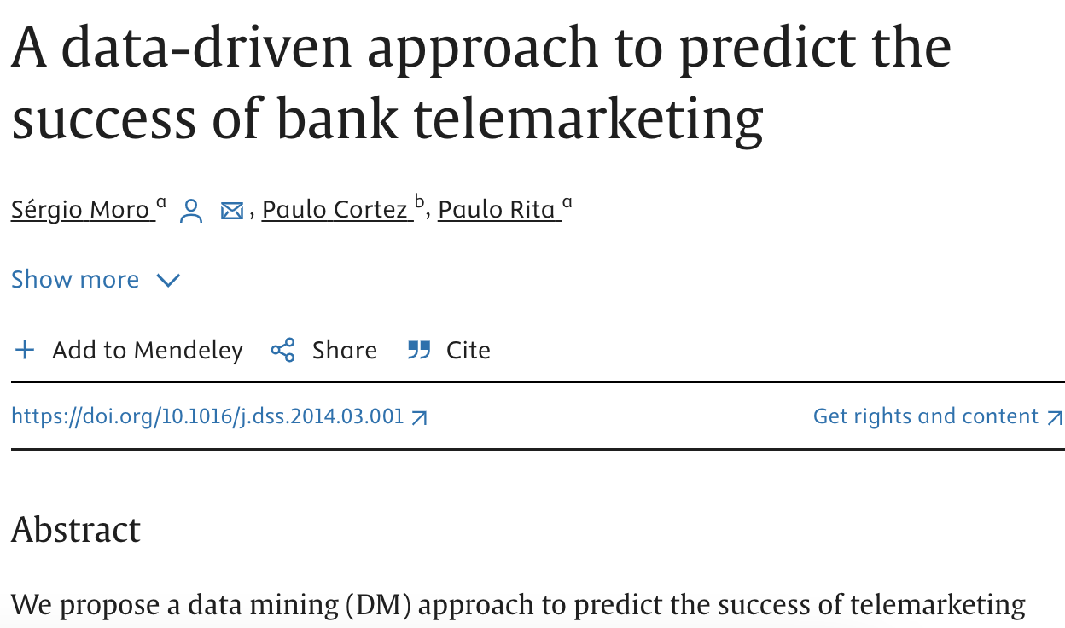
Business Model 2: Conclusion
Results are not as good as BM1!!!
>Original dataset is huge (about 150 predictors)
>Should add more predictors
SVM and Random Forest have better performance.
>Base on the results, since it is costly for banks to miss out potential customers who would like to subscribe, it is worth it to use better models to predict given that we only have very little information.
>
Notes:
quite hard to predict without forward contact information

Slide 67
Business Model 2: Conclusion

Slide 68
Overall Conclusion

Slide 69
Future work
Explore a wider range of hyperparameters tuning.
Explore more models such as other ensemble models like XGBoost etc.
Collect more info for predicting the future campaign.

